Slide 1
Lab Mid Exam
Experiment Name: banking app and Class diagram of online shopping
Course Title: System analysis and design
Course Code: CSE 325
Submitted To:
Supta Richard Philip
Senior Lecturer
Department of CSE
City University Dhaka
Submitted By:
Name: Md. Harun Or Rashid
ID: 171442552
Batch: 44th

Slide 2
UML use case diagram - Banking system
"Banks offer many different channels to access their banking and other services: (1) Automated Teller Machines. (2) A branch is a retail location. (3) Call center. (4) Mail: most banks accept cheque deposits via mail and use mail to communicate to their customers, by sending out statements. (5) Mobile banking is a method of using one's mobile phone to conduct banking transactions. (6) Online banking is a term used for performing multiple transactions, payments etc. over the Internet. (7) Relationship Managers, mostly for private banking or business banking, often visiting customers at their homes or businesses. (8) Telephone banking is a service which allows its customers to conduct transactions over the telephone with automated attendant or when requested with telephone operator. (9) Video banking is a term used for performing banking transactions or professional banking consultations via a remote video and audio connection. Video banking can be performed via purpose built banking transaction machines (similar to an Automated teller machine), or via a video conference enabled bank branch clarification.

Slide 3
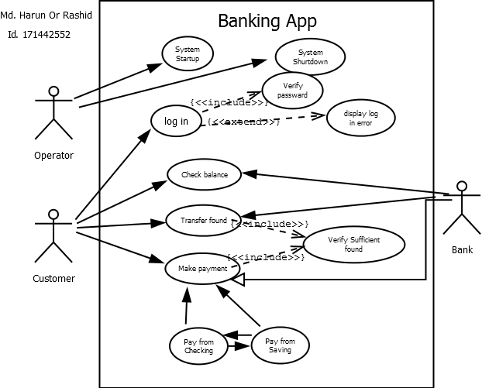

Slide 4
Class diagram of online shopping
service login() requires variables username and password typed String as input variables, returns a variable typed Boolean to indicate customer successful login. The required resource is defined. In which, the login state of customer are represented in variable LoginState with basic type Boolean. The current customer is represented as variable CurrentCustomer with the type Customer. This is not a basic type such as Float, Double, String, Boolean, and Date, but is a domain concept. This complex type should contain at least attributes such as Name: String, Password: String and balance: Double, and it can be represented as a domain conceptual class of UML. Once we define all the interfaces of the system like above interface Manage account if, we can forge the domain model by UML conceptual class diagram. The conceptual class diagram describes abstract and meaningful concepts in the problem domain, and it decomposes the problem regarding individual concepts. This is an important trophy in requirement analysis. Therefore, we can tell that service refinement can help UML to get the more precisely model about the target system in at least requirement election

Slide 5
